Slide 1

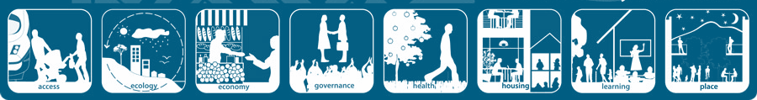
Factors Affecting the Liveability of Suburbs

Slide 2

To understand the factors that affect the liveability of suburbs

Slide 3

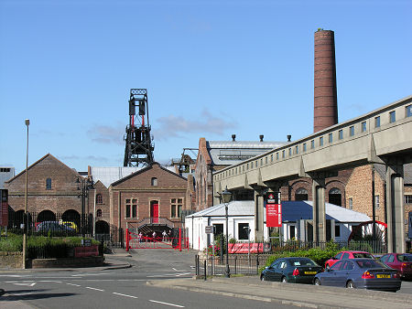
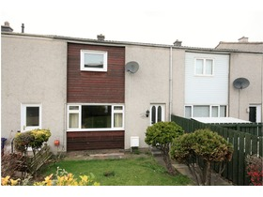

Slide 4
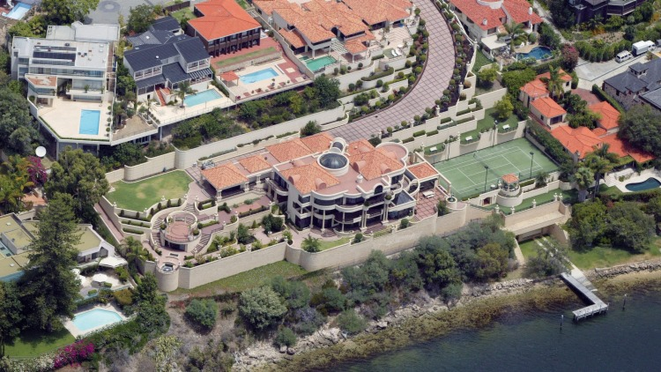
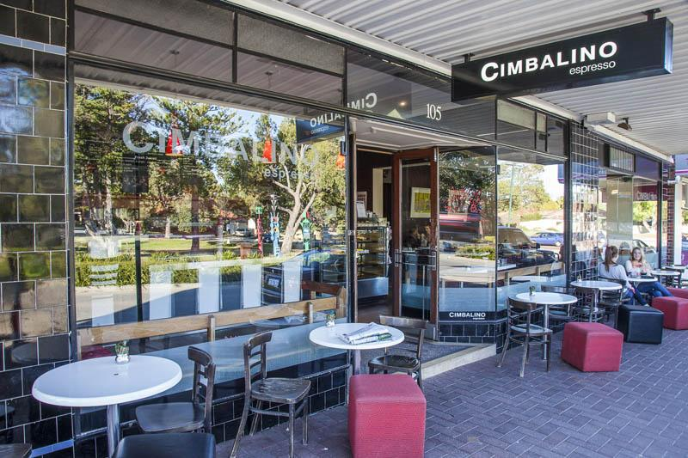

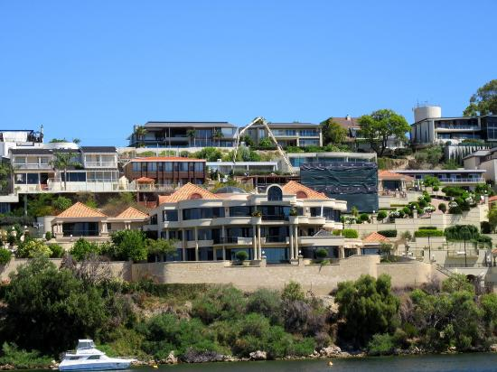

Slide 5
Dalkeith, WA
Dalkeith, UK

Slide 6

'Liveability' - the qualities of a place (city, town, suburb, neighbourhood) that contribute to the quality of life experienced by residents and others.

Slide 7
‘Liveability’ –
suburbs/neighbourhoods
The liveability of suburbs and neighbourhoods depends on the environmental and social quality of a place as perceived by residents, workers, customers and visitors to the area.
These factors include:

Slide 8
Factors affecting the liveability of a suburb.
Environmental
Cleanliness, dust, pollution, noise, air and water quality, aesthetics, climate landscape
personal security, traffic safety, community identity and pride, neighbourliness, connectedness
Social
historic structures, mature trees, traditional architectural styles, streetscapes, belief, traditions, backgrounds
Cultural
Economic
Value of property, employment opportunities, affluence, investment
streets, public transport, health, shopping centres, schools, religious institutions, parks and sporting facilities, other public facilities, communications.
Infrastructure

Slide 9



Small cows eat every icecream

Slide 10
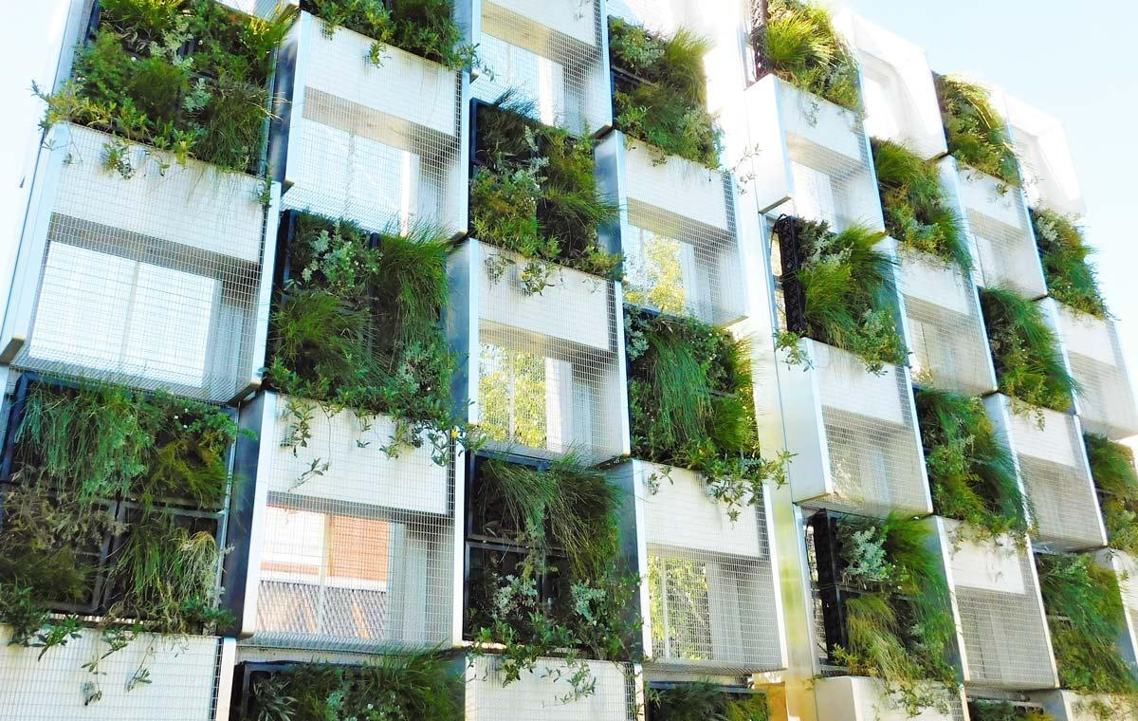
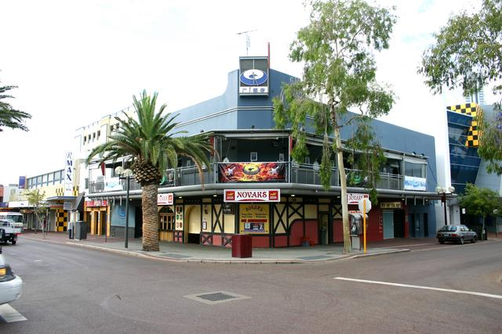
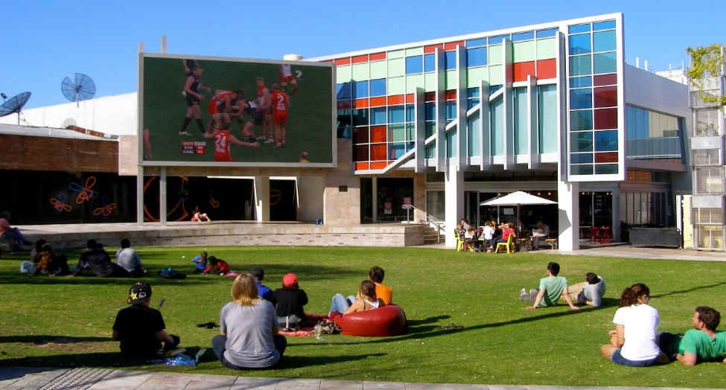
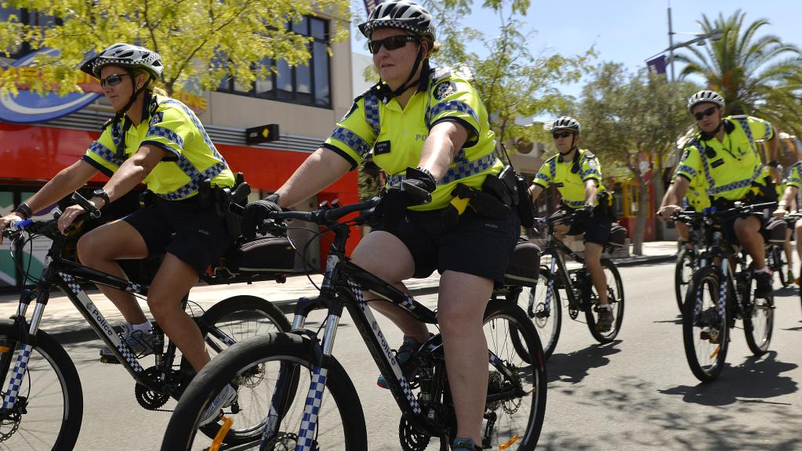
How liveable is Northbridge to a student?
Would it be more or less liveable to a family?
Use the map and the photos below as well as your schema

Slide 11


So now we need to assess the liveability of your suburb
Write a TEEL paragraph (10 sentences) evaluating your home suburb's liveability - consider the factors taught in class - 15 mins max
Evaluate

